Slide 1

Erda Acres Water Company
2024 Annual Meeting
Annual Letter
Agenda Items:
1. Water system status, connections, usage, 2024 recap and 2025 initiatives.
2. FY 2024 final budget.
3. FY 2025 proposed budget.
4. Proposed rate adjustment
5. Shareholder Q&A.
6. Board member election (if needed) – MW, LB, BT, TI, JJ.
7. Shareholder Adjourn.
8. November 2024 board meeting.
Recommendations:
1. If needed, use portion of $10 & $5 base rate to cover any budget shortfall in fiscal year 2024.
2. Add Cross Connection Control Administrator position
3. Approve proposed rate increase.
EAWC Overview:
In FY 2024 EAWC finances experienced significant pressure, only one new connection, influenced by macro economy and Comcast issues. Board elected to pay-off Nelson well generator. Resulting in a net loss in FY 2024. FY 2025 budget proposal includes new rate structure.
FY 2024 included a continued slowdown in new construction (only one new connection).
In 2020 EAW started using our chlorination system. The system has operated with no major issues for almost 5 years. Upgrade to add chlorination to the Scada system pushed to FY 2025.
The water system, which includes a storage tank, two wells, two water pumps, a booster station, a two generators and a distribution system. All are functioning properly. Repairs and upgrades to the system are consistently required to address meter reading issues, leaks, and operation of fire hydrants. Erda Acres has established a regular maintenance schedule to ensure proper functionality and increase asset longevity.
Erda Acres continues efforts to identify shareholders with backflow prevention devices connected to their irrigation systems. Federal and State laws require water companies to identify installed backflow devices and track annual certified inspections.
The proposed budget for 2024- 2025, the minutes from last year’s Shareholder Meeting, the voting proxy form and this year’s meeting agenda are posted at www.erdawater.com.

Slide 2
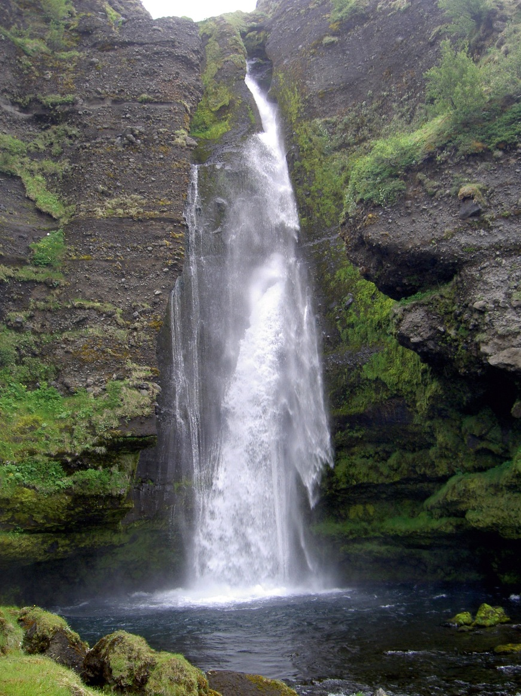
Erda Acres Water Company
2024 Annual Meeting
Fiscal Year 2024 Highlights
Completed Sanitary Survey - no negative points awarded.
Tank cleaning completed.
Continued construction slowdown in 2024 – one new connection added to Erda Acres Water.
Cross Connection Control Program is functioning (upgrade meters, irrigation backflow).
Working on adding to chlorination system to the Scada system.
Routine maintenance and service to the Campbell well Cla-valve.
Nelson well generator paid in full
GIS system functional.
All water tests completed and passed.
Lead and Copper service line inventory project (EPA requirement) completed.
Water Usage
New billing/accounting system - AVR and Quickbooks operating for over a year.
Continued interest in using remaining connections commercial and residential.
Hired an operator to replace Alan Clark - Levi Mele
Comcast problems

Slide 3

Erda Acres Water Company
2024 Annual Meeting
2024 Water Usage

Slide 4

Erda Acres Water Company
2024 Annual Meeting
Water Usage Summary

Slide 5

Erda Acres Water Company
2024 Annual Meeting
Water Usage Summary

Slide 6

Erda Acres Water Company
2024 Annual Meeting
2024 – 2025 Fiscal Year project list.
Replace 6 Meter Boxes $4,000
Retro Setter 20 Units $10,000
Replace 3-6 Fire Hydrants $32,000
Scada Upgrade $8,000
Line Detector $2,500
Parts for 8” line break (2) $1,200
Source Protection Plan $2,000
Total $59,700

Slide 7
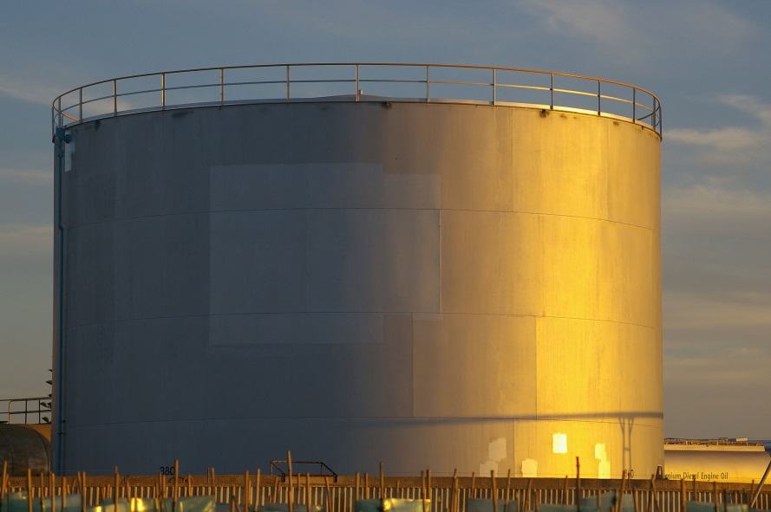
Project Explanation
Erda Acres Water Company
2024 Annual Meeting
Scada Importance.
  Chlorine system is not visible on Scada.
  Increases efficiency of operating water system and helps reduce expenses.
  Vital for operational efficiency (operator and state reporting).
  Scada provider has been working on this in FY 2024 not completed
Cross Connection.
  State allows gradual improvement.
  State requires back flow prevention device at meter connection.
  Retrosetter - allows upgrade to a backflow prevention, avoids complete replacement
  6 meter boxes
  3-6 fire hydrants.
2 Connectors - 8" MJ L/P SLV C153 IMP-4 Megalug
  Start building inventory for any future leak.
Line Detector Equipment.
  Current device is over 10 years old, outdated technology
Source Protection Plan Implementation.
Tasks from SPP submitted 3 years ago.

Slide 8

Erda Acres Water Company
2024 Annual Meeting
Loan Schedule
Year Principal Loan balance
2010 $21,000 $1,599,000 Loan Amount is $2,120,000, of which $1,620,000 is the Loan Proceeds and
2011 $22,000 $1,577,000 $500,000 shall be Principal Forgiveness if payments are made on time.
2012 $24,000 $1,553,000
2013 $26,000 $1,527,000 Total of 30 year payment schedule $1,620,000
2014 $27,000 $1,500,000
2015 $29,000 $1,471,000 Balance as of 9/30/2024 was $542,030
2016 $30,000 $1,441,000
2017 $33,000 $1,408,000 Balance as of 10/10/2024 was $488,030
2018 $36,000 $1,372,000
2019 $39,000 $1,333,000
2020 $42,000 $1,291,000
2021 $45,000 $1,246,000
2022 $48,000 $1,198,000
2023 $51,000 $1,147,000
2024 $54,000 $1,093,000
2025 $57,000 $1,036,000
2026 $59,000 $977,000
2027 $61,000 $916,000
2028 $63,000 $853,000
2029 $65,000 $788,000
2030 $67,000 $721,000
2031 $70,000 $651,000
2032 $72,000 $579,000
2033 $75,000 $504,000
2034 $77,000 $427,000
2035 $79,000 $348,000
2036 $82,000 $266,000
2037 $85,000 $181,000
2038 $88,000 $93,000
2039 $93,000 $-
Total $1,620,000

Slide 9

Erda Acres Water Company
2024 Annual Meeting
Water rate increase proposal.
The Board is recommending a water rate increase to occur during fiscal year 2018-2019.
  EAWC has not increased rates tier rates since 2018.
  The stability of our water rates is due to the increased number of connections.
  Cost of expenses has increased.
    Comcast damage added almost $19K
  Compared SPID, Tooele City and Granstville Rates
  Current water rates:
    $55.00 monthly base fee
    $0.75 for each 1,000 gallons of water used up to 70,000 gallons
    $1.25 for each 1,000 gallons of water used over 70,000 gallons up to 140,000 gallons
    $1.75 for each 1,000 gallons of water used over 140,000 gallons
  Proposed water rate structure (prorated tiers):
    $55.00 monthly base fee
    $1.00 for each 1,000 gallons of water used up to 50,000 gallons
    $1.60 for each 1,000 gallons of water used over 50,000 gallons up to 100,000 gallons
    $2.25 for each 1,000 gallons of water used over 100,000 gallons up to 150,000 gallons
    $3.25 for each 1,000 gallons of water used over 150,000 gallons

Slide 10
Erda Acres Water Company
2024 Annual Meeting
Water rate increase Example
 | Water Bill Example
 | Tiers | Rate | Calculation | Bill Amount | Gallons - O | Gallons - N | Bill Amount | Calculation | Rate | Tiers
Example 1 | Base | $55 |  | $ 55.00 |  |  | $ 55.00 |  | $55 | Base
 | 0-70,000 | $0.75/1,000 | (67821/1000)*0.75 | $ 50.87 | 67,821 | 50,000 | $ 50.00 | (50000/1000)*1.00 | $1.00/1,000 | 0-50,000
 | 70,001-140,000 | $1.25/1,000 |  |  |  | 17,821 | $ 28.51 | (17821/1000)*1.60 | $1.60/1,000 | 50,001-100,000
 | >140,000 | $1.75/1,000 |  |  |  |  |  |  | $2.25/1,000 | 100,001-150,000
 |  |  |  |  |  |  |  |  | $3.25/1,000 | >150,000
 |  |  | Total | $ 105.87 | 67,821 | 67,821 | $ 133.51 | Total
 | Tiers | Rate | Calculation | Bill Amount | Gallons - O | Gallons - N | Bill Amount | Calculation | Rate | Tiers
Example 2 | Base | $55 |  | $ 55.00 |  |  | $ 55.00 |  | $55 | Base
 | 0-70,000 | $0.75/1,000 | (67821/1000)*0.75 | $ 37.50 | 70,000 | 50,000 | $ 50.00 | (50000/1000)*1.00 | $1.00/1,000 | 0-50,000
 | 70,001-140,000 | $1.25/1,000 | (70000/1000)*1.25 | $ 87.50 | 70,000 | 50,000 | $ 80.00 | (50000/1000)*1.60 | $1.60/1,000 | 50,001-100,000
 | >140,000 | $1.75/1,000 | (43413/1000)*1.75 | $ 75.97 | 43413 | 50,000 | $ 112.50 | (50000/1000)*2.25 | $2.25/1,000 | 100,001-150,000
 |  |  |  |  |  | 33,413 | $ 108.59 | (33413/1000)*3.25 | $3.25/1,000 | >150,000
 |  |  | Total | $ 255.97 | 183,413 | 183,413 | $ 406.09 | Total

Slide 11
Erda Acres Water Company
2024 Annual Meeting
Example supporting rate increase

Slide 12

Erda Acres Water Company
2024 Annual Meeting
Rate Comparison

Slide 13

Erda Acres Water Company
2024 Annual Meeting
Directory
Operator
Alan Clark: 435-496-3468 (cell); erdaacresoperator@gmail.com.
Levi Mele: 219-252-2614 (cell); levilmele@gmail.com.
2024 Board Members
Tom Isom, President (expire odd) – possible vacancy
801-660-7306; tisom2000@yahoo.com
Rob Adams, Vice President (expire odd)
801-673-9092; wingmanut@gmail.com
Blanche Smith, Treasurer (expire even) – possible vacancy
435-850-9106 (M); erdaacres@gmail.com
Michael Webb, Secretary (expire even) – possible vacancy
385-252-1519 (M); webbmike3609@gmail.com
• Please reach out if contact of additional board members is needed.
Additional Board Members:
Brian Townley (position is open)
Larry Brown (position is open)
Jake Jacobson (position is open)
Dave Gunderson
Phyllis Kimpel

Slide 14

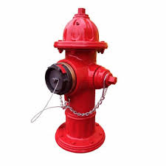
Erda Acres Water Company
2024 Annual Meeting
Looking ahead to 2025
Board changes - need to replace 6 positions
  President
  Secretary
  Treasurer/Bookeeper (replacement found)
  3 board positions (one replacement found)
Rate structure
County wide development
Is there Shareholder interest in becoming a licensed operator (primary or non-primary)?
Continued integration of new billing/account system
Meter Box upgrades (cross connection program)
Replace up to 6 Fire Hydrants
Input data into GIS system
2025 Rural Water Conference
Interest in development around Excelsior (commercial and residential).

Slide 15
Erda Acres Water Company
2024 Annual Meeting
Cross Connection Reminder
Backflow prevention.
Remember water can flow two directions in a hose or irrigation system.
An unexpected drop in water pressure may reverse water flow from a hose into your home.
Some helpful hints.
Ensure water leaving a hose runs through an air space gap of at least 2 inches before it enters into a container.
Another tip is to make sure there is a hose-bib vacuum breaker attached to all outdoor spigots.
As a reminder state law and the plumbing code require a certified backflow preventer. All lawn irrigation systems installed since 2006 are required to have either a Reduced Pressure Principle (RP) Backflow Prevention Assembly (most common) or a Pressure Vacuum Breaker (PVB) Backflow Prevention Assembly.
Both of these are installed above ground and are testable.

